Slide 1
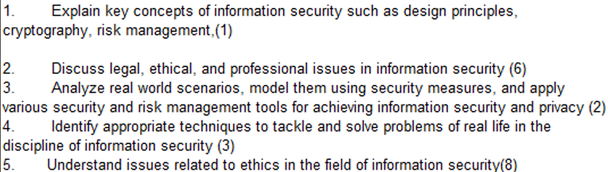
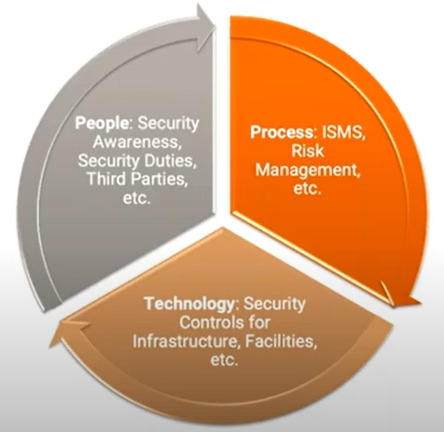
CS 3002 Information Security
Fall 2023
Week # 8
Dr. Aqsa Aslam

Slide 2
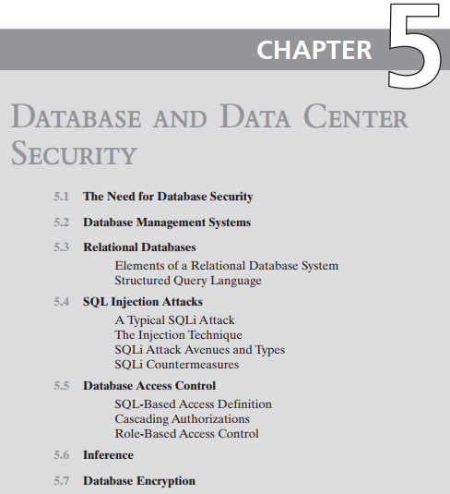
Self Study

Slide 3
Database security
SQL Injection Attack
Steps involved in a typical SQL Injection attack
The Injection techniques
SQL Injection attack types
In-band, out-of-band, inferential

Slide 4
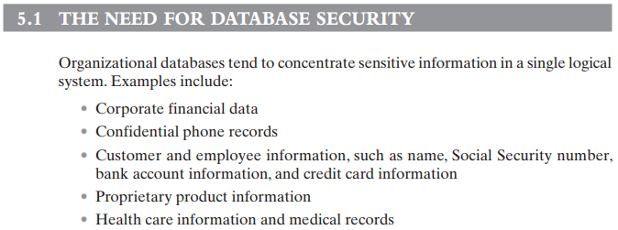

Slide 5
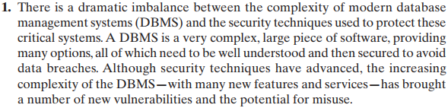
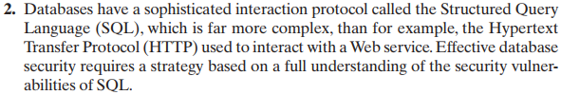
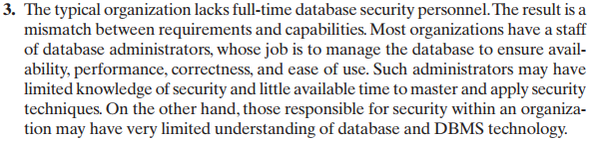
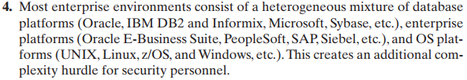

Slide 6
Important SQL Syntax
COMMENTS: --
Example: SELECT * FROM `table` --selects everything
LOGIC: ‘a’=‘a’
Example: SELECT * FROM `table` WHERE ‘a’=‘a’
MULTI STATEMENTS: S1; S2
Example: SELECT * FROM `table`; DROP TABLE `table`;

Slide 7
The SQL injection (SQLi) attack is one of the most prevalent and dangerous network-based security threats.
An SQLi attack is designed to exploit the nature of Web application pages.
Most current websites have dynamic components and content. Many such pages ask for information, such as location, personal identity information, and credit card information. This dynamic content is usually transferred to and from back-end databases that contain volumes of information.
An application server webpage will make SQL queries to databases to send and receive information critical to making a positive user experience.
In such an environment, an SQLi attack is designed to send malicious SQL commands to the database server.
The most common attack goal is bulk extraction of data.
Attackers can dump database tables with hundreds of thousands of customer records.
Depending on the environment, SQL injection can also be exploited to modify or delete data, execute arbitrary operating system commands, or launch denial-of-service (DoS) attacks.

Slide 8
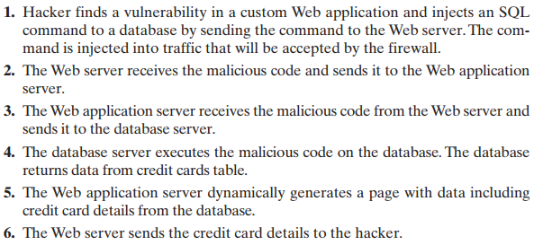

Slide 9
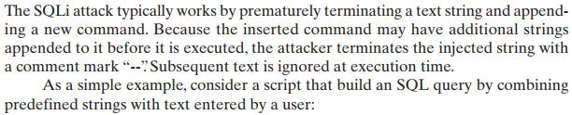


Slide 10
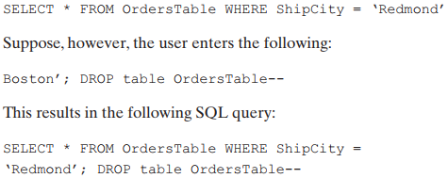
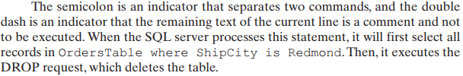

Slide 11
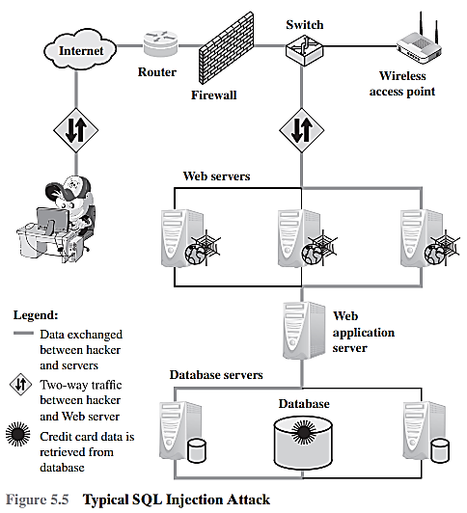
3 – Tier Architecture

Slide 12
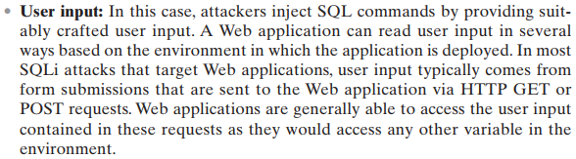
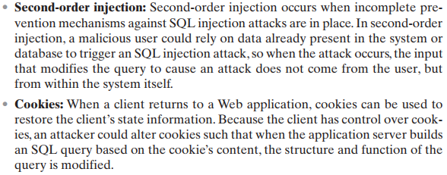
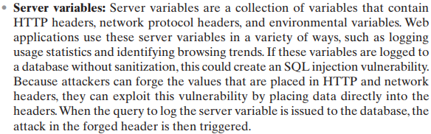
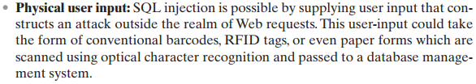

Slide 13
Attack types can be grouped into three main categories: inband, inferential, and out-of-band.
An in-band attack uses the same communication channel for injecting SQL code and retrieving results. The retrieved data are presented directly in the application webpage.
With an inferential attack, there is no actual transfer of data, but the attacker is able to reconstruct the information by sending particular requests and observing the resulting behavior of the website / database server.
In an out-of-band attack, data are retrieved using a different channel (e.g., an e-mail with the results of the query is generated and sent to the tester). This can be used when there are limitations on information retrieval, but outbound connectivity from the database server is lax.

Slide 14
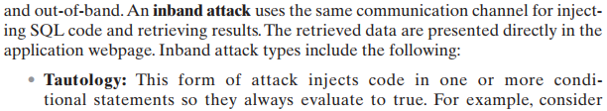

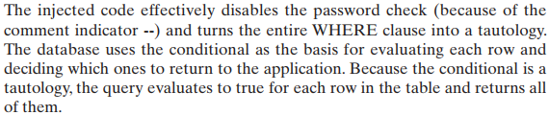
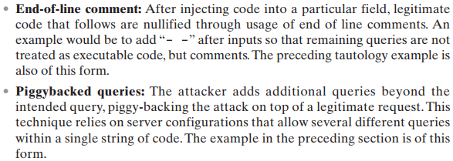

Slide 15
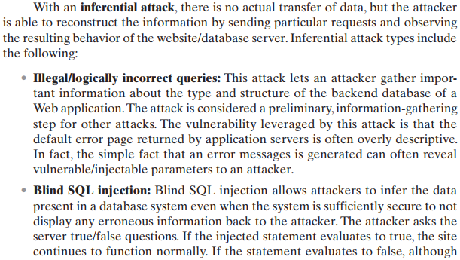

Slide 16

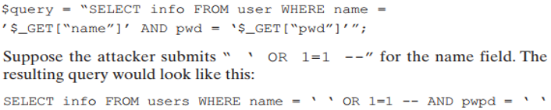
SQL Injection – Summary

Slide 17
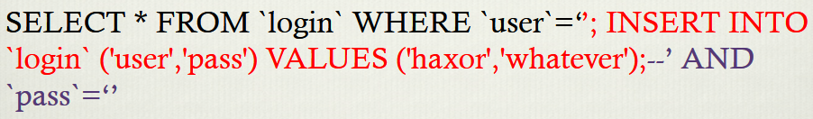
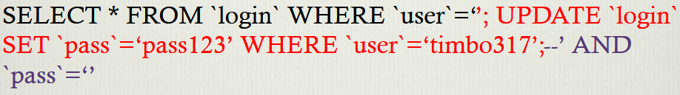
SQL Injection – Summary

Slide 18
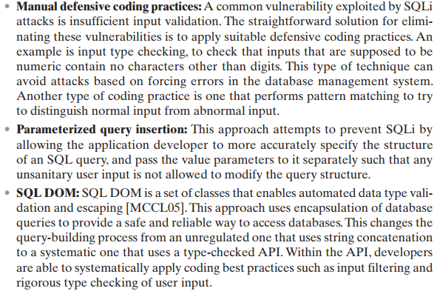
(1)

Slide 19
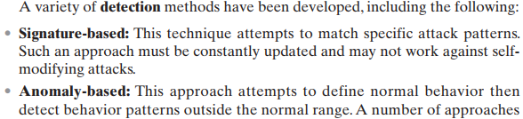
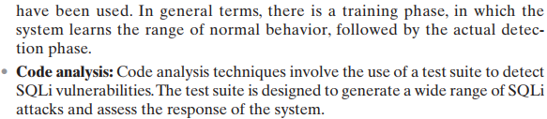
(2)

Slide 20
Database Access Control (Section 5.6)
Grant command
Revoke command
Discretionary vs Role-based Access control in databases
Fixed Roles in Microsoft SQL Server
Cascading Authorizations
Disclosure of database information through Inference (Section 5.7)
Understanding Inference
Case for Inference: Employee Schema

Slide 21
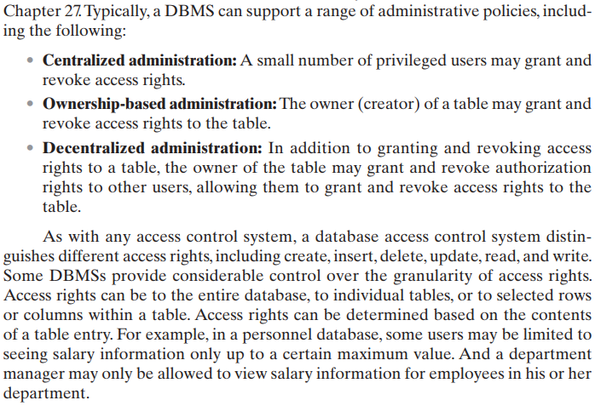

Slide 22
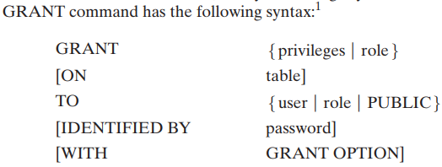
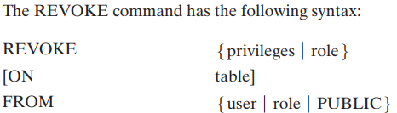
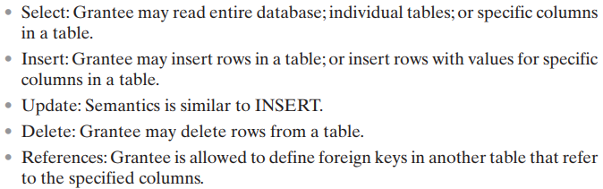
Example: Grant Select On any table To ALICE

Slide 23
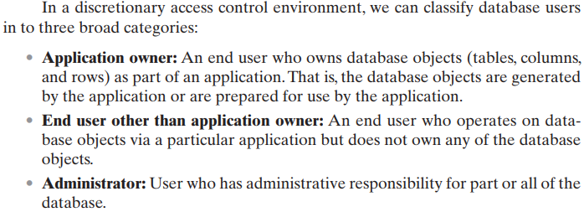

Slide 24
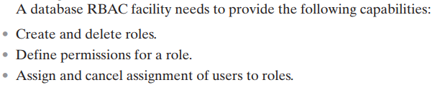
A role-based access control (RBAC) scheme is a natural fit for database access control.
Unlike a file system associated with a single or a few applications, a database system often supports dozens of applications.
In such an environment, an individual user may use a variety of applications to perform a variety of tasks, each of which requires its own set of privileges.
It would be poor administrative practice to simply grant users all of the access rights they require for all the tasks they perform.
RBAC provides a means of easing the administrative burden and improving security.

Slide 25
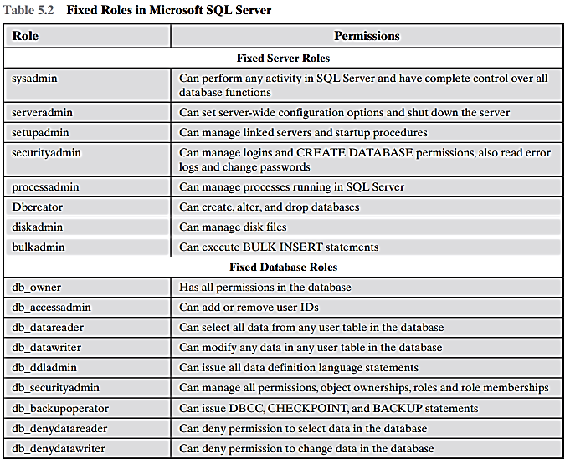

Slide 26
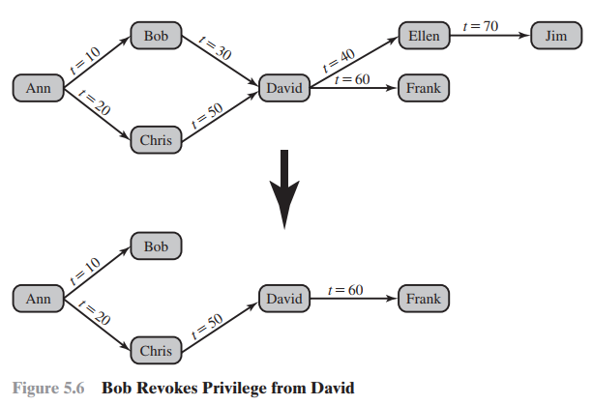
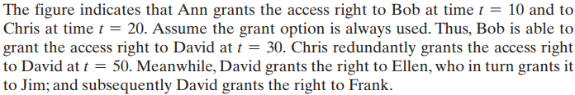
Suppose Bob revokes the privilege from David. David still has the access right because it was granted by Chris at t = 50.
The access rights to Ellen and Jim is revoked when Bob revokes the access right to David.
Why? This is because at t = 40, when David granted the access right to Ellen, David only had the grant option to do this from Bob. When Bob revokes the right, this causes all subsequent cascaded grants that are traceable solely to Bob via David to be revoked.

Slide 27

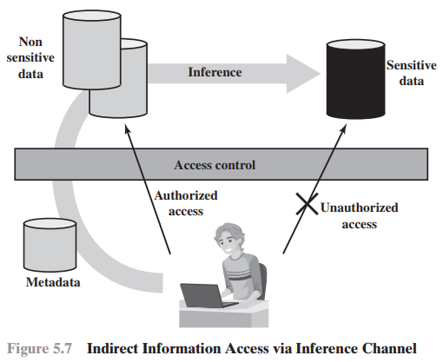
Metadata refers to knowledge about correlations or dependencies among data items that can be used to deduce information not otherwise available to a particular user.
Inference, as it relates to database security, is the process of performing authorized queries and deducing unauthorized information from the legitimate responses received.
The inference problem arises when the combination of a number of data items is more sensitive than the individual items, or when a combination of data items can be used to infer data of higher sensitivity.
Figure 5.7 illustrates the process. The attacker may make use of non sensitive data as well as metadata. The information transfer path by which unauthorized data is obtained is referred to as an inference channel.
Two inference techniques can be used to derive additional information:
Analyzing functional dependencies between attributes within a table or across tables, and
Merging views with the same constraints.

Slide 28
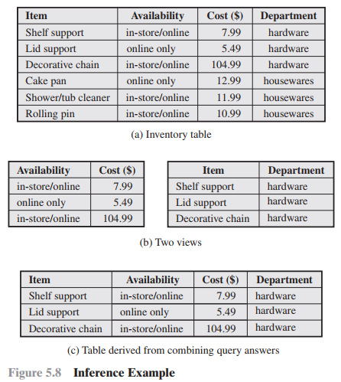
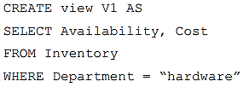
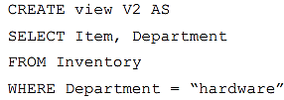
A user who knows the structure of the Inventory table and who knows that the view tables maintain the same row order as the Inventory table is then able to merge the two views to construct the table shown in Figure 5.8c. This violates the access control policy that the relationship of attributes Item and Cost must not be disclosed.

Slide 29
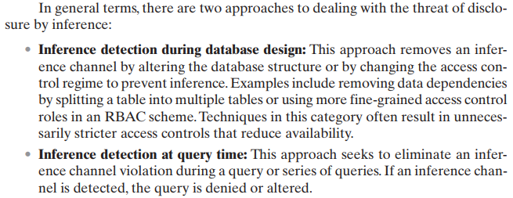
How to dead with the threat of disclosure by inference?

Slide 30
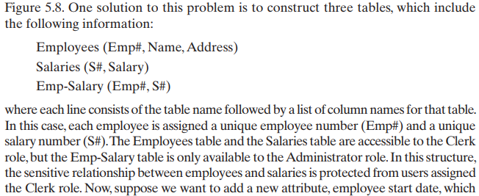
Consider a database containing personnel information, including names, addresses, and salaries of employees. Individually, the name, address, and salary information is available to a subordinate role, such as Clerk, but the association of names and salaries is restricted to a superior role, such as Administrator.
Create a small database schema to hold the above information. How we safeguard against inference?
In which table a new attribute, employee start date could be added if it is not sensitive?

Slide 31
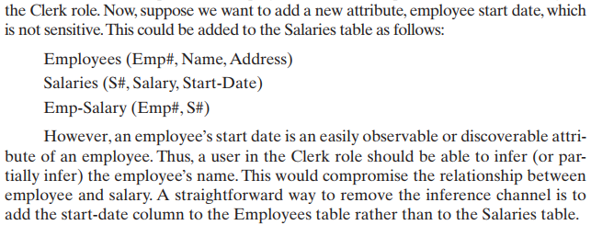
Consider a database containing personnel information, including names, addresses, and salaries of employees. Individually, the name, address, and salary information is available to a subordinate role, such as Clerk, but the association of names and salaries is restricted to a superior role, such as Administrator.
In which table a new attribute, employee start date could be added if it is not sensitive?

Slide 32
Database Encryption (Section 5.7)
Actors in a Database Encryption Scheme
Whole Database Encryption Scheme (Figure 5.9)
Row Encryption Scheme (Figure 5.10, Table 5.3)
How row-wise encryption scheme works?
Performance and other improvements

Slide 33
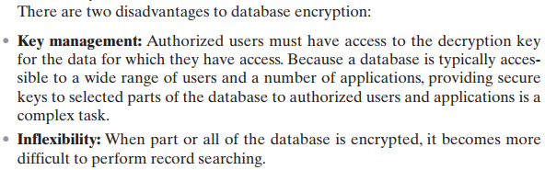
Encryption becomes the last line of defense in database security.
Encryption can be applied to the (i) entire database, (ii) at the record level (encrypt selected records), (iii) at the attribute level (encrypt selected columns), or at the level of the individual field.

Slide 34
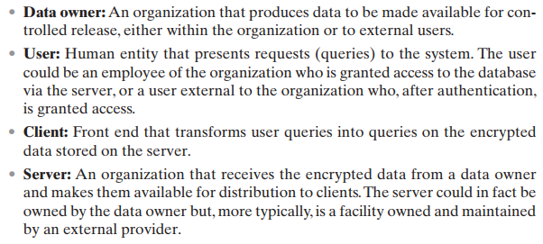
Actors in a Database Encryption Scheme

Slide 35
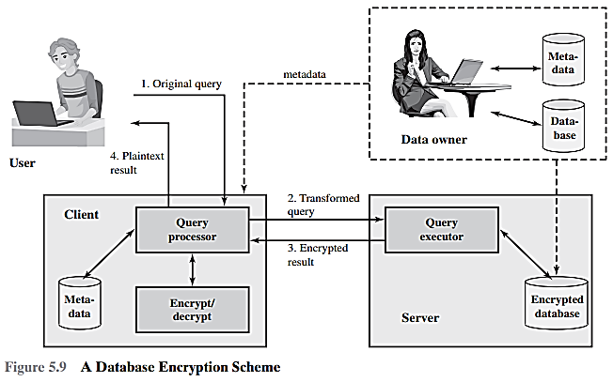

Slide 36


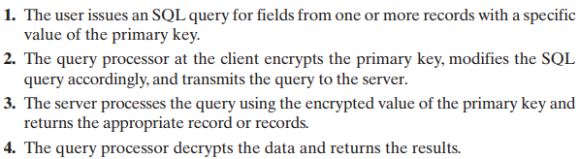
1.
Assume the encryption key k is used and the encrypted value of the department id 15 is E(k, 15) = 1000110111001110.
2.
3.
If the user wishes to retrieve all records for salaries less than $70K. There is no obvious way to do this, because the attribute value for salary in each record is encrypted. The set of encrypted values do not preserve the ordering of values in the original attribute.
4.

Slide 37
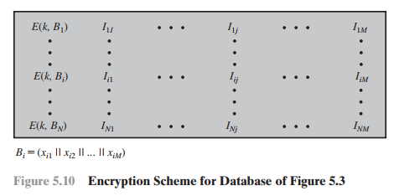
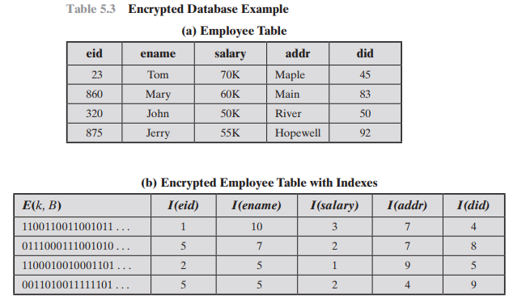
Alternate Approach (1)
Each row Ri is treated as a contiguous block forming a sequence of bits, and all of the attribute values for that row are concatenated together to form a single binary block.
The entire row is encrypted.
Shown as I_{i1}, I_{i2}, I_{i3}, … are indexes are associated with each attribute of the table.

Slide 38
Alternate Approach (2)
Suppose employee ID (eid) values lie in the range [1, 1000].
We can divide these values into five partitions: [1, 200], [201, 400], [401, 600], [601, 800], and [801, 1000]; then assign index values 1,2, 3, 4, and 5, respectively.
23 → partition 1
860 → partition 5
320 → partition 2
875 → partition 5

Slide 39
Alternate Approach (3)
This arrangement provides for more efficient data retrieval. Suppose, for example, a user requests records for all employees with eid < 300.
The query processor requests all records with I(eid) = 2.
These are returned by the server.
The query processor decrypts all rows returned, discards those that do not match the original query, and returns the requested unencrypted data to the user.
The indexing scheme just described does provide a certain amount of information to an attacker, namely a rough relative ordering of rows by a given attribute. To obscure such information, the ordering of indexes can be randomized.
For example, the eid values could be partitioned by mapping [1, 200], [201, 400], [401, 600], [601, 800], and [801, 1000] into 2, 3, 5, 1, and 4, respectively. Because the metadata are not stored at the server, an attacker could not gain this information from the server.

Slide 40
Alternate Approach (4)
To increase the efficiency of accessing records by means of the primary key, the system could use the encrypted value of the primary key attribute values, or a hash value.
In either case, the row corresponding to the primary key value could be retrieved individually.
Different portions of the database could be encrypted with different keys, so users would only have access to that portion of the database for which they had the decryption key.
This latter scheme could be incorporated into a role-based access control system.

